Slide 1
Cancer statistics 2008-2013

Slide 2
Dataset
Types of cancers
Region
States
Sex
Count
Year

Slide 3
Tasks
Can check the number of cancer cases per state
Can view the major cancers in that particular state
Cancer Count can be viewed group by Region and Year
Can view gender wise cancers rates

Slide 4
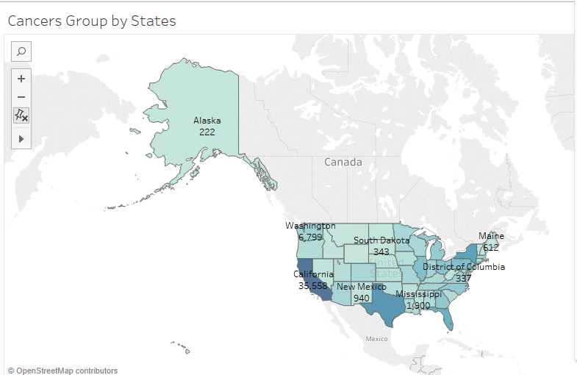
Visualization 1

Slide 5
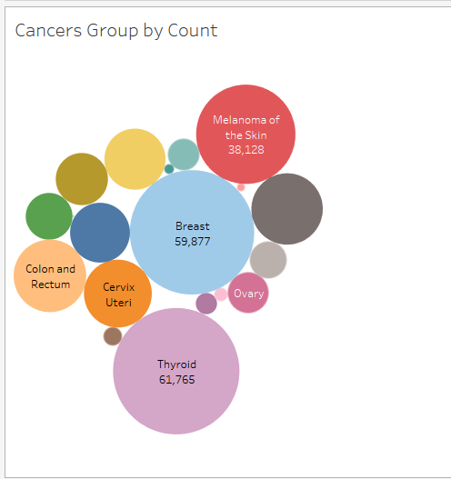
Visualization 2

Slide 6
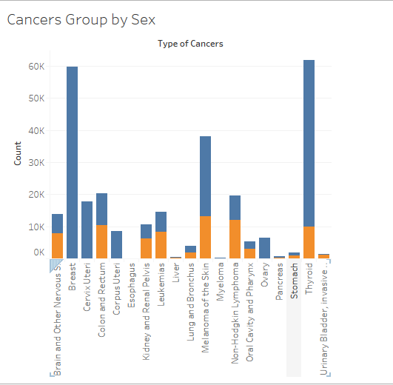
Visualization 3

Slide 7
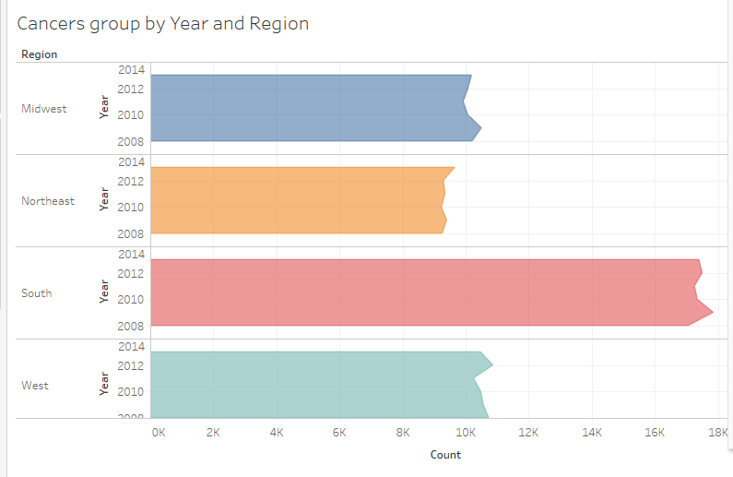
Visualization 4

Slide 8
Tableau Link https://public.tableau.com/profile/alekhya.akkinepally#!/vizhome/CancerStatistics_0/CancerStatistics?publish=yes References: Centers for Disease Control and Prevention

